Slide 1



MACHINE LEARNING
Module-1
Target-3 ,Batch-07

Slide 2


Presenting by:
Batch-7
211FA04003 –T.SHANMUKHA SUDHA KIRAN
211FA04284- P.SAIRAM
211FA04289 - S.SRIPUJITHA
211FA04358 -G. VAMSI

Slide 3
CONTENTS:
ABSTRACT
PROBLEM STATEMENT
INTRODUCTION
ALGORITHM
OUTPUT
CONCLUSION
REFERENCE

Slide 4
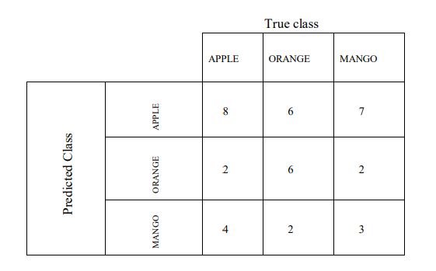
ABSTRACT:
In this PPT we begin by introducing about confusion matrix, confusion matrix has been provided to evaluate the performance of a classifier. The matrix depicts the predicted classes against the true classes. From this, various performance evaluation measures have been calculated.
PROBLEM STATEMENT:
A dataset has three class labels, namely Apple, Orange and Mango. The following is a possible confusion matrix for these classes.

Slide 5
For reference: Accuracy = (true positives + true negatives) / (total examples) Precision = (true positives) / (true positives + false positives) Recall = (true positives) / (true positives + false negatives) F1 score = (2 * precision * recall) / (precision + recall) Find the class wise performance evaluation
measures and analyze which class accuracy is more out three classes. Also, measure the algorithm for classifier’s F1 score (as a value form 0 to 1.
INTRODUCTION:
CONFUSION MATRIX:
A confusion matrix is a matrix that summarizes the performance of a machine learning model on a set of test data.
ACCURACY:
Accuracy is one metric for evaluating classification models. Informally, accuracy is the fraction of predictions our model got right. Formally, accuracy has the following definition: Accuracy = Number of correct predictions Total number of predictions.
Accuracy = (true positives + true negatives) / (total examples)

Slide 6
PRECISION:
Precision is one indicator of a machine learning model's performance – the quality of a positive prediction made by the model.
Precision = (true positives) / (true positives + false positives)
RECALL:
Recall, also known as the true positive rate (TPR), is the percentage of data samples that a machine learning model correctly identifies as belonging to a class of interest—the “positive class”—out of the total samples for that class.
Recall = (true positives) / (true positives + false negatives)
F1-SCORE:
F1 score is a machine learning evaluation metric that measures a model's accuracy. It combines the precision and recall scores of a model.
F1 score = (2 * precision * recall) / (precision + recall)

Slide 7
ALGORITHM:
start
2. Import necessary libraries if needed.
3. Initialize variables:
- Create an empty dictionary `d` to store class indices and names.
- Create an empty dictionary `e` to store accuracy values and corresponding class indices.
- Initialize `tp`, `tn`, `fp`, and `fn` to 0 for counting.
4. Input the number of classes (`m`) from the user.
5. Input class names and store them in the dictionary `d`:
- Loop over `m` times:
- Input a class name and store it in the dictionary with its index.

Slide 8
Initialize an empty list `matrix` to store the confusion matrix values.
7. Input confusion matrix values for each class:
- Loop over `m` times for each row:
- Initialize an empty list `l` for the current row.
- Loop over `m` times for each column:
- Input a confusion matrix value and append it to list `l`.
- Append the list `l` to the matrix.
8. For each class index `i` (0 to `m-1`):
- Calculate true positives (`tp`):
- Assign the value from `matrix[i][i]` to `tp`.
- Initialize `fp` and `fn` to 0 for counting false positives and false negatives.

Slide 9
9. Nested loops for calculating false positives (`fp`), false negatives (`fn`), and true negatives (`tn`):
- Loop over `m` times for each predicted class `j`:
- If `i` is not equal to `j`:
- Increment `fp` by `matrix[i][j]`.
- Increment `fn` by `matrix[j][i]`.
- Loop over `m` times for each actual class `k`:
- Increment `tn` by `matrix[j][k]`.
- Adjust `tn` by subtracting the sum of `tp`, `fp`, and `fn`.
10. Calculate accuracy using the `accuracy` function:
- Calculate `acc` using the provided formula and values (`tp`, `tn`, `fp`, `fn`).
11. Calculate precision using the `precision` function:

Slide 10
- Calculate `pre` using the provided formula and values (`tp`, `fp`).
12. Calculate recall using the `recall` function:
- Calculate `rec` using the provided formula and values (`tp`, `fp`).
13. Calculate F1 score using the `f1score` function:
- Calculate `score` using the provided formula and values (`pre`, `rec`).
14. Print evaluation measures for the current class:
- Print TP, TN, FP, FN, accuracy, precision, recall, and F1 score.
- Reset counters `tp`, `tn`, `fp`, and `fn` to 0.
15. After looping through all classes, find the class with the maximum accuracy:
- Determine the class index with the maximum accuracy from dictionary `e`.
- Print the class name with the maximum accuracy.
16.Stop

Slide 11
SOURCE CODE:
def accuracy(tp,tn,fp,fn):
acc=(tp+tn)/(tp+tn+fp+fn)
return acc
def precision(tp,fp):
pre=tp/(tp+fp)
return pre
def recall(tp,fp):
rec=tp/(tp+fn)
return rec
def f1score(pre,rec):
score=(2*pre*rec)/(pre+rec)
return score
m=int(input("enter the no of classes: "))
matrix=[]
d={}
e={}
tp=tn=fp=fn=0
print("Enter the names of the class: ")
for i in range(m):
p=input()
d[i]=p
print("Now enter the values:")
for i in range(m):
l=[]

Slide 12
for j in range(m):
n=int(input())
l.append(n)
matrix.append(l)
for i in range(m):
tp=matrix[i][i]
for j in range(m):
if(i!=j):
fp=fp+matrix[i][j]
fn=fn+matrix[j][i]
for k in range(m):
tn=tn+matrix[j][k]
tn=tn-(tp+fp+fn)
acc=accuracy(tp,tn,fp,fn)
e[acc]=i
pre=precision(tp,fp)
rec=recall(tp,fp)
score=f1score(pre,rec)
print("*******************for class ",d[i]," values are: ")
print()
print()
print("tp tn fp tn :",tp ,tn ,fp ,fn)
print("Accuracy is: ",acc)
print("precision is: ",pre)

Slide 13
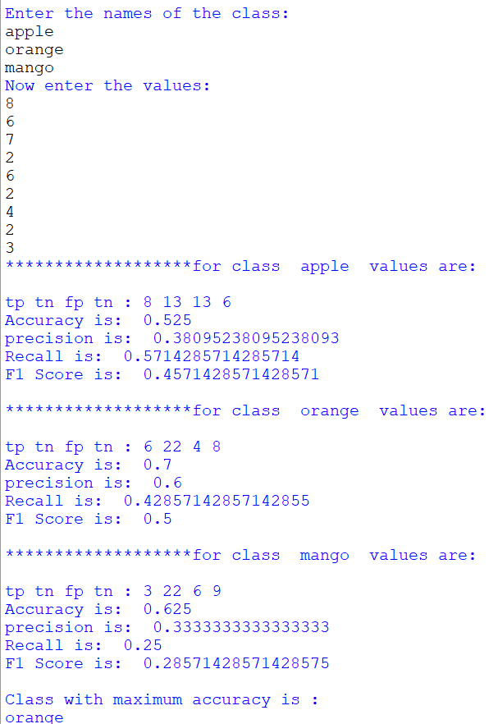
OUTPUTS:
print("Recall is: ",rec)
print("F1 Score is: ",score)
print()
tp=tn=fp=fn=0
print("Class with maximum accuracy is :")
print(d[e[max(e)]])

Slide 14
CONCLUSION:
In conclusion, the evaluation measures reveal that the Orange class exhibits the highest accuracy, precision, and recall among the three classes. Furthermore, the F1 score reinforces the Orange class's strong performance as a classifier.
REFERENCE:
https://www.geeksforgeeks.org/confusion-matrix-machine-learning/
https://www.javatpoint.com/confusion-matrix-in-machine-learning

Slide 15

From:
Group-07

